Slide 1
Cloud Elevate –Exam Readiness workshop AWS Certified Developer - Associate
Developing and Deepening
Cloud skills @ATCI

Slide 2
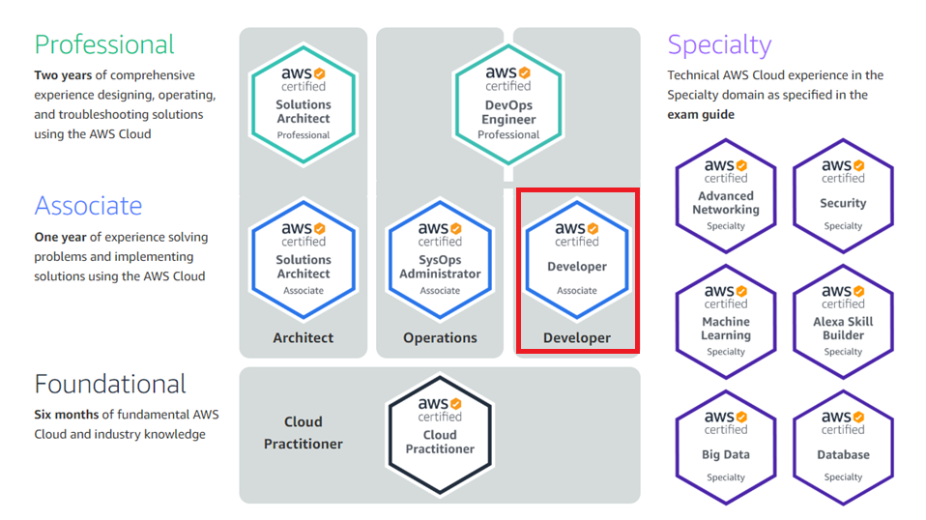
AWS CERTIFICATION PATH
https://aws.amazon.com/certification/
2

Slide 3
AWS Developer - associate
AWS Developer - Associate Exam Guide (Exam Blueprint)
Domain | % of Exam
a. Deployment | 22%
b. Security | 26%
c. Development with AWS | 30%
d. Refactoring | 10%
e. Monitoring and Troubleshooting | 12%
Total | 100%

Slide 4
Monitoring and Troubleshooting – 12%
Objectives
Write code that can be monitored
Perform root-cause analysis on faults found in testing or production

Slide 5
Monitoring and Troubleshooting – 12%
Key AWS Services
Amazon CloudWatch
Amazon CloudTrail

Slide 6

Amazon Cloud Watch
Monitoring and management service that provides data and actionable insights for your AWS resources
Monitor
Collect logs
Provides real-time monitoring of your AWS resources and the applications you run on AWS
Monitors AWS built-in and custom metrics
Collects and processes log files from services and applications
Detects events and responds with notifications or automated responses
Amazon CloudWatch
Alarm
Respond to events

Slide 7






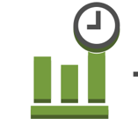
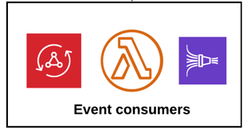
Example
Memory Utilization
(Custom metric)
Dashboard
CPU Utilization
(Standard metric)
EC2 instance with CloudWatch
Detailed Monitoring
EC2 instance with CloudWatch
Detailed Monitoring
Notification
CloudWatch
CPU Utilization > x%
(CloudWatch Alarm)
Daily 8 PM Event Trigger
(Scheduled Event Rule)
Lambda - Scheduled Shutdown of EC2 instance

Slide 8
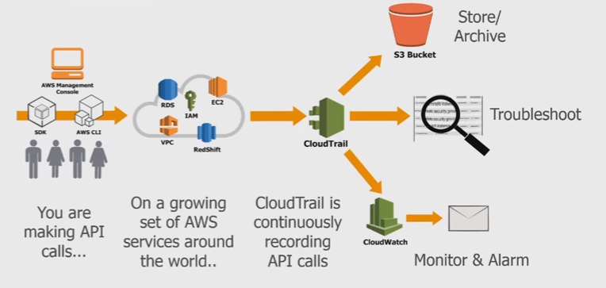
Cloud trail
Log, continuously monitor, and retain account activity related to actions across your AWS infrastructure
Supported for a growing number of AWS services
A number of AWS partners integrate with CloudTrail
Records API calls (including Console) for most major AWS services
Automatically pushes logs to Amazon S3 once configured

Slide 9
CloudTrail
AWS CloudTrail can help you answer questions requiring detailed analysis
Who shut down a specific instance?
Who changed a security group configuration?
Is any activity coming from an unknown IP address range?
What activities were denied due to lack of permissions?

Slide 10
Sample Questions
. Your team is performing load testing for an application. This application is making use of DynamoDB tables. They need to monitor the throughput for the table to ensure that the Consumed capacity does no go beyond the throughout capacity. Which of the following service would you use for this purpose?
a. AWS Cloudwatch
b. AWS Cloudtrail
c. AWS SQS
d. AWS SNS

Slide 11
Sample Questions
. Your team is performing load testing for an application. This application is making use of DynamoDB tables. They need to monitor the throughput for the table to ensure that the Consumed capacity does no go beyond the throughout capacity. Which of the following service would you use for this purpose?
a. AWS Cloudwatch
b. AWS Cloudtrail
c. AWS SQS
d. AWS SNS

Slide 12
Sample Questions
Change management procedures at an organization require that a log is kept recording activity within AWS
accounts. The activity that must be recorded includes API activity related to creating, modifying or deleting
AWS resources. Which AWS service should be used to record this information?
a. Amazon CloudWatch
b. Amazon CloudTrail
c. AWS X-Ray
d. AWS OpsWorks

Slide 13
Sample Questions
Change management procedures at an organization require that a log is kept recording activity within AWS
accounts. The activity that must be recorded includes API activity related to creating, modifying or deleting
AWS resources. Which AWS service should be used to record this information?
a. Amazon CloudWatch
b. Amazon CloudTrail
c. AWS X-Ray
d. AWS OpsWorks

Slide 14
Sample Questions
A Developer is writing a serverless application that will process data uploaded to a file share. The Developer
has created an AWS Lambda function and requires the function to be invoked every 15 minutes to process
the data. What is an automated and serverless way to trigger the function?
a. Deploy an Amazon EC2 instance based on Linux, and edit it’s /etc/crontab file by adding a command to
periodically invoke the Lambda function
b. Configure an environment variable named PERIOD for the Lambda function. Set the value at 600
c. Create an Amazon CloudWatch Events rule that triggers on a regular schedule to invoke the Lambda
function
d. Create an Amazon SNS topic that has a subscription to the Lambda function with a 600-second timer

Slide 15
Sample Questions
A Developer is writing a serverless application that will process data uploaded to a file share. The Developer
has created an AWS Lambda function and requires the function to be invoked every 15 minutes to process
the data. What is an automated and serverless way to trigger the function?
a. Deploy an Amazon EC2 instance based on Linux, and edit it’s /etc/crontab file by adding a command to
periodically invoke the Lambda function
b. Configure an environment variable named PERIOD for the Lambda function. Set the value at 600
c. Create an Amazon CloudWatch Events rule that triggers on a regular schedule to invoke the Lambda
function
d. Create an Amazon SNS topic that has a subscription to the Lambda function with a 600-second timer

Slide 16
Sample Questions
You are now the IT administrator for your company. The company has a set of servers sitting in AWS and a set of them sitting in their On-premise locations. They want to monitor the system level metrics for both sets of servers and have a unified dashboard for monitoring. Which of the following can help in this regard? Choose 2 answers from the options given below.
a. Install the cloudwatch agent on both sets of servers b. Migrate the on-premise servers to AWS to ensure they can be monitored c. Setup the metrics dashboard in Cloudwatch d. Setup the metrics dashboard in Cloudtrail

Slide 17
Sample Questions
You are now the IT administrator for your company. The company has a set of servers sitting in AWS and a set of them sitting in their On-premise locations. They want to monitor the system level metrics for both sets of servers and have a unified dashboard for monitoring. Which of the following can help in this regard? Choose 2 answers from the options given below.
a. Install the cloudwatch agent on both sets of servers b. Migrate the on-premise servers to AWS to ensure they can be monitored c. Setup the metrics dashboard in Cloudwatch d. Setup the metrics dashboard in Cloudtrail

Slide 18
Sample Questions
A large digital enterprise uses Amazon EFS for its storage application. EFS mount points are created in multiple AZ’s. QA team is interested in getting dashboard for total throughput of data being accessed from EFS mount point across all AZ’s for quality assurance. Which of the following steps can be taken to get total throughput of EFS in a scalable manner with least efforts ?
a. Export Amazon CloudWatch log data for each EFS to Amazon S3 bucket for metric TotalIOBytes & calculate total throughput manually.
b. Export Amazon CloudWatch log data for each EFS to Amazon S3 bucket for metric TotalIOBytes & use Amazon Athena/ Amazon QuickSight to create a customised dashboard.
c. Create an Amazon CloudWatch graph with metric math expression to get total throughput for all EFS with metric as TotalIOBytes.
d. Create an Amazon CloudWatch graph for each EFS with metric as TotalIOBytes & manually calculate total throughput with sum of TotalIOBytes over required time period.

Slide 19
Sample Questions
A large digital enterprise uses Amazon EFS for its storage application. EFS mount points are created in multiple AZ’s. QA team is interested in getting dashboard for total throughput of data being accessed from EFS mount point across all AZ’s for quality assurance. Which of the following steps can be taken to get total throughput of EFS in a scalable manner with least efforts ?
a. Export Amazon CloudWatch log data for each EFS to Amazon S3 bucket for metric TotalIOBytes & calculate total throughput manually.
b. Export Amazon CloudWatch log data for each EFS to Amazon S3 bucket for metric TotalIOBytes & use Amazon Athena/ Amazon QuickSight to create a customised dashboard.
c. Create an Amazon CloudWatch graph with metric math expression to get total throughput for all EFS with metric as TotalIOBytes.
d. Create an Amazon CloudWatch graph for each EFS with metric as TotalIOBytes & manually calculate total throughput with sum of TotalIOBytes over required time period.

Slide 20
Sample Questions
A large digital enterprise uses Amazon EFS for its storage application. EFS mount points are created in multiple AZ’s. QA team is interested in getting dashboard for total throughput of data being accessed from EFS mount point across all AZ’s for quality assurance. Which of the following steps can be taken to get total throughput of EFS in a scalable manner with least efforts ?
a. Export Amazon CloudWatch log data for each EFS to Amazon S3 bucket for metric TotalIOBytes & calculate total throughput manually.
b. Export Amazon CloudWatch log data for each EFS to Amazon S3 bucket for metric TotalIOBytes & use Amazon Athena/ Amazon QuickSight to create a customised dashboard.
c. Create an Amazon CloudWatch graph with metric math expression to get total throughput for all EFS with metric as TotalIOBytes.
d. Create an Amazon CloudWatch graph for each EFS with metric as TotalIOBytes & manually calculate total throughput with sum of TotalIOBytes over required time period.

Slide 21
Sample Questions
Web application servers are deployed on EC2 instance in VPC created in us-east-1 region. Last week there was a planned event to update security policy of these EC2 instance, but due to a manual error outage was observed. As a preventive measure, you need to create a process to evaluate these security policies post deployment Which of the following actions will suffice to assess network exposure post any changes in Security Group in most effective way?
a. Initiate a network connection between EC2 instance to any destination outside VPC & use VPC Flow logs to evaluate open ports with Security Group.
b. Install third-party Network Port Scanning Tool on EC2 instance launched in a VP
c. Install an Amazon Inspector Agent on EC2 instance launched in a VPC to evaluate security groups.
d. Add a CloudWatch Event rule to automatically trigger Network Assessment post changes in security groups.

Slide 22
Sample Questions
Web application servers are deployed on EC2 instance in VPC created in us-east-1 region. Last week there was a planned event to update security policy of these EC2 instance, but due to a manual error outage was observed. As a preventive measure, you need to create a process to evaluate these security policies post deployment Which of the following actions will suffice to assess network exposure post any changes in Security Group in most effective way?
a. Initiate a network connection between EC2 instance to any destination outside VPC & use VPC Flow logs to evaluate open ports with Security Group.
b. Install third-party Network Port Scanning Tool on EC2 instance launched in a VP
c. Install an Amazon Inspector Agent on EC2 instance launched in a VPC to evaluate security groups.
d. Add a CloudWatch Event rule to automatically trigger Network Assessment post changes in security groups.

Slide 23
Sample Questions
Web application servers are deployed on EC2 instance in VPC created in us-east-1 region. Last week there was a planned event to update security policy of these EC2 instance, but due to a manual error outage was observed. As a preventive measure, you need to create a process to evaluate these security policies post deployment Which of the following actions will suffice to assess network exposure post any changes in Security Group in most effective way?
a. Initiate a network connection between EC2 instance to any destination outside VPC & use VPC Flow logs to evaluate open ports with Security Group.
b. Install third-party Network Port Scanning Tool on EC2 instance launched in a VP
c. Install an Amazon Inspector Agent on EC2 instance launched in a VPC to evaluate security groups.
d. Add a CloudWatch Event rule to automatically trigger Network Assessment post changes in security groups.

Slide 24
Sample Questions
You have developed an application that is putting custom metrics into Cloudwatch. You need to generate alarms on a 10 second interval based on the published metrics. Which of the following needs to be done to fulfil this requirement?
a. Enable basic monitoring
b. Enable detailed monitoring
c. Create standard resolution metrics
d. Create high resolution metrics

Slide 25
Sample Questions
You have developed an application that is putting custom metrics into Cloudwatch. You need to generate alarms on a 10 second interval based on the published metrics. Which of the following needs to be done to fulfil this requirement?
a. Enable basic monitoring
b. Enable detailed monitoring
c. Create standard resolution metrics
d. Create high resolution metrics

Slide 26
Sample Questions
You have developed an application that is putting custom metrics into Cloudwatch. You need to generate alarms on a 10 second interval based on the published metrics. Which of the following needs to be done to fulfil this requirement?
a. Enable basic monitoring
b. Enable detailed monitoring
c. Create standard resolution metrics
d. Create high resolution metrics

Slide 27
Sample Questions
An application is publishing a custom CloudWatch metric any time an HTTP 504 error appears in the application error logs. These errors are being received intermittently. There is a CloudWatch Alarm for this metric and the Developer would like the alarm to trigger ONLY if it breaches two evaluation periods or more. What should be done to meet these requirements?
a. Update the CloudWatch Alarm to send a custom notification depending on results
b. Publish the value zero whenever there are no “HTTP 504” errors
c. Use high – resolution metrics to get data pushed to CloudWatch more frequently
d. The evaluation period and Data Points to Alarm should be set to 2 while creating this alarm

Slide 28
Sample Questions
An application is publishing a custom CloudWatch metric any time an HTTP 504 error appears in the application error logs. These errors are being received intermittently. There is a CloudWatch Alarm for this metric and the Developer would like the alarm to trigger ONLY if it breaches two evaluation periods or more. What should be done to meet these requirements?
a. Update the CloudWatch Alarm to send a custom notification depending on results
b. Publish the value zero whenever there are no “HTTP 504” errors
c. Use high – resolution metrics to get data pushed to CloudWatch more frequently
d. The evaluation period and Data Points to Alarm should be set to 2 while creating this alarm

Slide 29
Sample Questions
An application is publishing a custom CloudWatch metric any time an HTTP 504 error appears in the application error logs. These errors are being received intermittently. There is a CloudWatch Alarm for this metric and the Developer would like the alarm to trigger ONLY if it breaches two evaluation periods or more. What should be done to meet these requirements?
a. Update the CloudWatch Alarm to send a custom notification depending on results
b. Publish the value zero whenever there are no “HTTP 504” errors
c. Use high – resolution metrics to get data pushed to CloudWatch more frequently
d. The evaluation period and Data Points to Alarm should be set to 2 while creating this alarm

Slide 30
Sample Questions
As an AWS systems administrator for your company, you have enabled CloudTrail logs for your company’s account. The head of IT operations has also advised that the logs need to be encrypted. As the AWS admin for the company, what advice would you offer?
a. Enable TLS certificate for the CloudTrail Logs.
b. CloudTrails logs are automatically encrypted, hence no cause for alarm.
c. Create bucket policy on the S3 to enforce encryption of this trails .
d. Use AWS KMS to encrypt the trails.

Slide 31
Sample Questions
As an AWS systems administrator for your company, you have enabled CloudTrail logs for your company’s account. The head of IT operations has also advised that the logs need to be encrypted. As the AWS admin for the company, what advice would you offer?
a. Enable TLS certificate for the CloudTrail Logs.
b. CloudTrails logs are automatically encrypted, hence no cause for alarm.
c. Create bucket policy on the S3 to enforce encryption of this trails .
d. Use AWS KMS to encrypt the trails.

Slide 32
Sample Questions
As an AWS systems administrator for your company, you have enabled CloudTrail logs for your company’s account. The head of IT operations has also advised that the logs need to be encrypted. As the AWS admin for the company, what advice would you offer?
a. Enable TLS certificate for the CloudTrail Logs.
b. CloudTrails logs are automatically encrypted, hence no cause for alarm.
c. Create bucket policy on the S3 to enforce encryption of this trails .
d. Use AWS KMS to encrypt the trails.

Slide 33
Sample Questions
Being an AWS administrator for a certain company which has AWS infrastructure in two regions., you are involved in architecting a web application environment. There is a requirement for monitoring API calls to ensure that auditing the environment for compliance is easy and follows strict security compliance requirements and also the logs should be encrypted. Which of the following would help to achieve this?
a. AWS VPC flow logs and Subnet logs.
b. AWS CloudTrail logs
c. Use request tracing .
d. AWS CloudTrail logs and CloudWatch logs.

Slide 34
Sample Questions
Being an AWS administrator for a certain company which has AWS infrastructure in two regions., you are involved in architecting a web application environment. There is a requirement for monitoring API calls to ensure that auditing the environment for compliance is easy and follows strict security compliance requirements and also the logs should be encrypted. Which of the following would help to achieve this?
a. AWS VPC flow logs and Subnet logs.
b. AWS CloudTrail logs
c. Use request tracing .
d. AWS CloudTrail logs and CloudWatch logs.

Slide 35
Sample Questions
Being an AWS administrator for a certain company which has AWS infrastructure in two regions., you are involved in architecting a web application environment. There is a requirement for monitoring API calls to ensure that auditing the environment for compliance is easy and follows strict security compliance requirements and also the logs should be encrypted. Which of the following would help to achieve this?
a. AWS VPC flow logs and Subnet logs.
b. AWS CloudTrail logs
c. Use request tracing .
d. AWS CloudTrail logs and CloudWatch logs.

Slide 36
Sample Questions
An organization has configured the custom metric upload with CloudWatch. The organization has given permission to its employees to upload data using CLI as well SDK. How can the user track the calls made to CloudWatch?
A. The user can enable logging with CloudWatch which logs all the activities
B. Use CloudTrail to monitor the API calls
C. Create an IAM user and allow each user to log the data using the S3 bucket
D. Enable detailed monitoring with CloudWatch

Slide 37
Sample Questions
An organization has configured the custom metric upload with CloudWatch. The organization has given permission to its employees to upload data using CLI as well SDK. How can the user track the calls made to CloudWatch?
A. The user can enable logging with CloudWatch which logs all the activities
B. Use CloudTrail to monitor the API calls
C. Create an IAM user and allow each user to log the data using the S3 bucket
D. Enable detailed monitoring with CloudWatch

Slide 38
Sample Questions
An organization has configured the custom metric upload with CloudWatch. The organization has given permission to its employees to upload data using CLI as well SDK. How can the user track the calls made to CloudWatch?
A. The user can enable logging with CloudWatch which logs all the activities
B. Use CloudTrail to monitor the API calls
C. Create an IAM user and allow each user to log the data using the S3 bucket
D. Enable detailed monitoring with CloudWatch

Slide 39
Happy Learning!!
39

